Slide 1
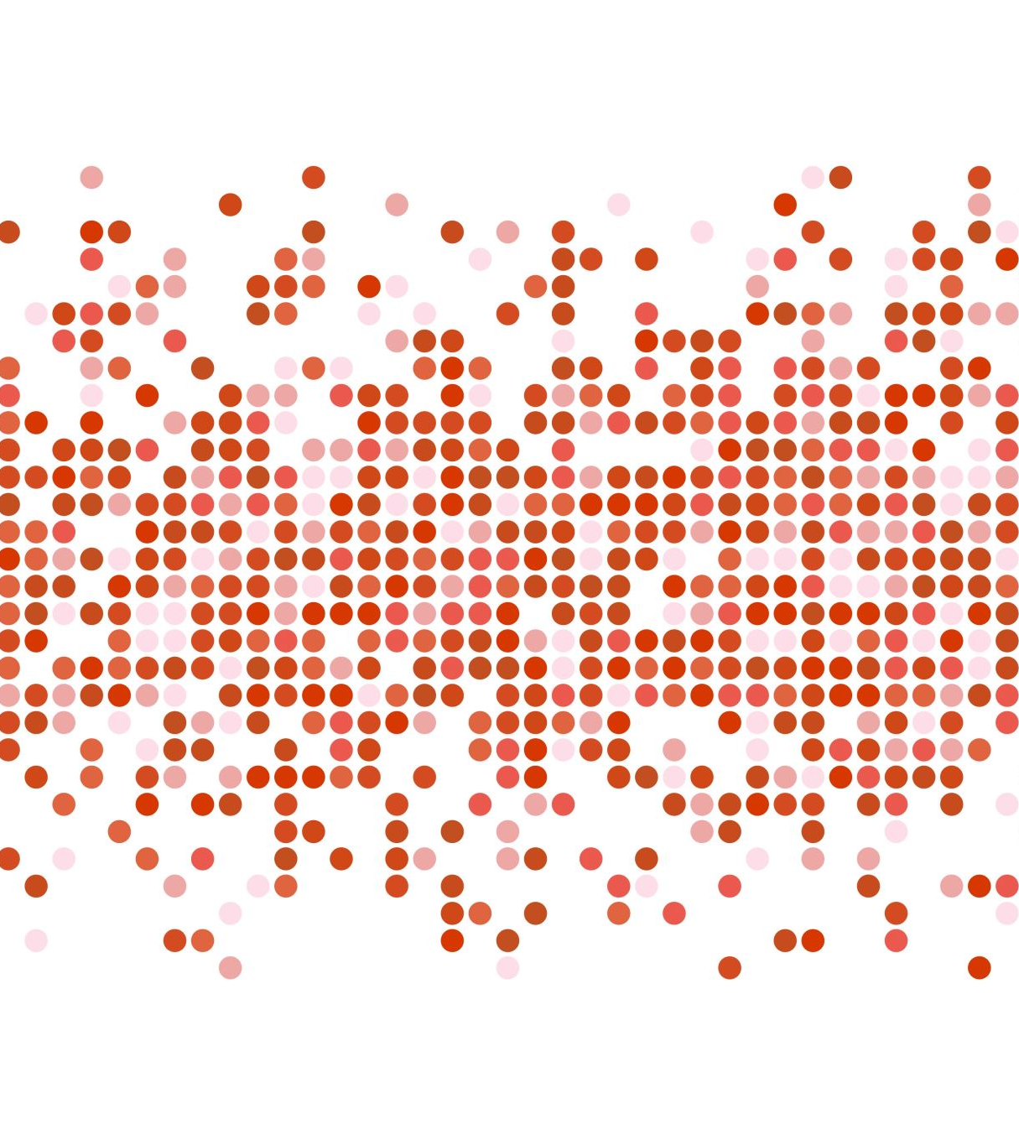
Natural Language Processing
Colin Tran

Slide 2
Agenda
Project Flow
Exploration
Model Result
Challenge

Slide 3
Project Flow
1
Retrieving data
2
Exploring
3
Cleaning data
4
Feature Engineering
5
Modeling

Slide 4
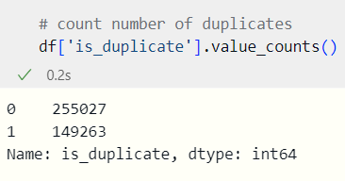
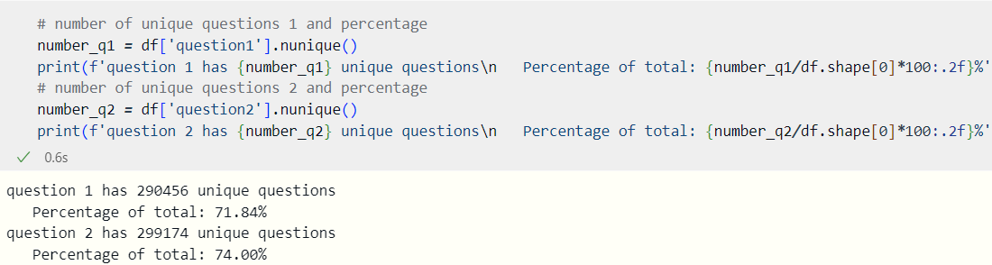
Exploring
36% of total question is duplicated
28.16% of question 1 is duplicated
26% of question 2 is duplicated

Slide 5
Modeling
 | Actual Positive (1) | Actual Negative(0)
Predicted Positive (1) | TPs: 44449 | FPs: 6421
Predicted Negative (0) | FNs 14326 | TNs: 15662
Logistic Model:
Accuracy: 0.74
 | Precision | Recall | F1-score | Support
0 | 0.76 | 0.87 | 0.81 | 50870
1 | 0.71 | 0.52 | 0.60 | 29988
accuracy |  |  | 0.74 | 80858
Macro avg | 0.73 | 0.72 | 0.71 | 80858
Weighted avg | 0.74 | 0.74 | 0.73 | 80858

Slide 6
Modeling
 | Actual Positive (1) | Actual Negative(0)
Predicted Positive (1) | TPs: 45468 | FPs: 5335
Predicted Negative (0) | FNs 10871 | TNs: 19184
Logistic Model:
Accuracy: 0.799
 | Precision | Recall | F1-score | Support
0
1
accuracy
Macro avg
Weighted avg

Slide 7

Challenge
Processing both the data and the model is a time-consuming task.

